Slide 1
Welcome to My Presentation
Hosnayra Khatun
Roll: 01-047-10

Slide 2
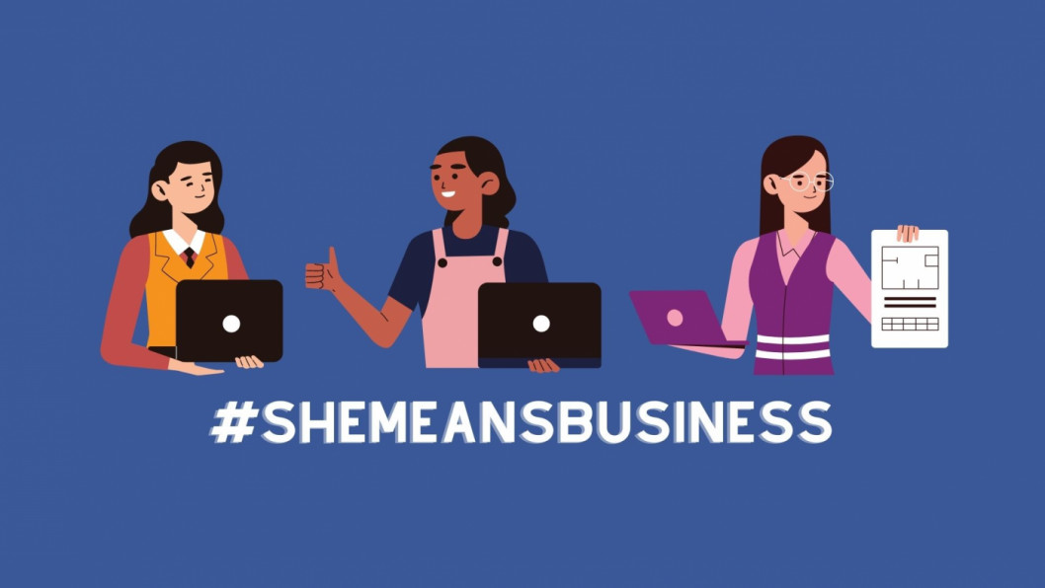
Facebook-Based Female Student Entrepreneurship

Slide 3
Introduction:
Growing role of social media in entrepreneurship
Empowering female students as business leaders
Why Facebook? Broad reach & cost-effective platform

Slide 4
Why Facebook for Entrepreneurship?
Global audience and diverse demographics
Tools: Facebook Pages, Groups, and Ads
Integration with e-commerce (Marketplace, Shops)

Slide 5
Opportunities for Female Students
Flexible work-life balance
Building personal brand and networks
Showcasing creativity and skills

Slide 6

Challenges:
Managing time with academics
Competition in saturated markets
Safety and privacy concerns

Slide 7
Benefits of Facebook-Based Entrepreneurship
Affordable startup model
Builds entrepreneurial confidence
Opportunity to scale beyond local markets

Slide 8

Thank You

